Slide 1
State Officer Candidate Information
Kentucky FFA

Slide 2
State Officer Roles and Expectations
Read the Candidate Handbook carefully
  Roles
  Responsibilities
  Expectations
Review the dates for training and other events
  Attendance is mandatory
  Exceptions require pre-approval

Slide 3
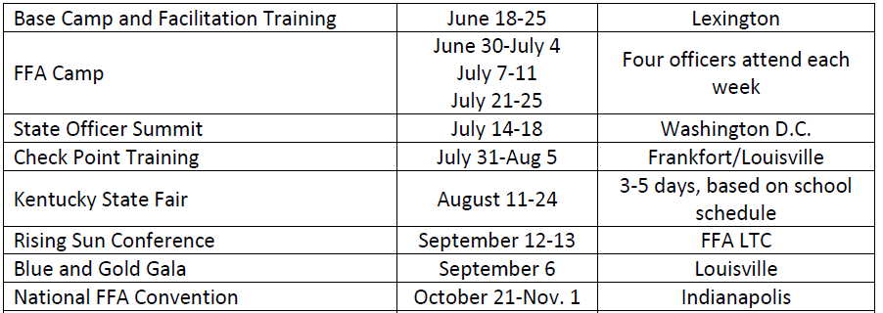
Summer/Fall Dates

Slide 4
Be the Brand
Behavior
Attitude
Appearance
Professionalism

Slide 5
State Officer Candidate Process
Each region can send TWO Candidates to State FFA Convention
  Candidates are selected at regional delegate meeting
  Dates and structure of selection processes differ
Candidates complete an online State Officer Candidate Application by May 15
All 24 Candidates interview at the State FFA Convention

Slide 6
Nominating Committee
12 student members
  Each region selects one member
  Must be a graduating senior who holds or is receiving the State FFA Degree
  Not from a school with a candidate
Chair
  Immediate past State President (or other officer)
Adult Consultants
  Two teacher educators
  Non-voting

Slide 7
Interview Rounds/Selection Components
1 on 13
1 on 1 (or 2)
Stand and Deliver
Stakeholder
Knowledge Exam

Slide 8
Situational/Behavioral Questions
“Tell us about a time you showed leadership.”
  Different committee members may be scoring different things
  Each will give you two scores per round (scores of 1, 2, 3, 4, or 5)
  Possible to get a 5 on 1 competency and a 1 on another
We NEVER ask
  If you were a candy bar, what candy bar would you be?
  Questions that have a right answer (who is the Commissioner of Agriculture?)
  Questions that require a controversial answer (what do you think about US immigration policy?)

Slide 9
Process at Convention
Arrive on Sunday, June 8 after lunch
Knowledge Exam and Round 1 on Sunday
One on One, Stakeholder, and Stand and Deliver on Monday
Committee scores each round
Scores go into the scoring system
No one knows anything on Monday
No additional data points (we are NOT following you with a clip board)

Slide 10
Competencies
Communication
Team Player
Areas of Knowledge
Character
Influence

Slide 11
How Should You Prepare?
Know yourself
Know your why
Think of specific examples
Practice answering questions and answering all parts of questions
Study for knowledge exam
Practice Stand and Deliver type scenarios
Come to Convention rested
Look your best
Be prepared for long days
  How will you manage down time
  How will you manage stress

Slide 12
Process at Convention
Wednesday Afternoon
  Committee meets to deliberate and vote on close regions
  Pre-set margin of consideration
  Ballot vote
  No one knows
Thursday Morning
  Committee sees final list
  Committee votes on final list
  Report is announced in 9:00 a.m. session
  Officers are elected and installed

Slide 13
The Rest of State Convention
Serve as an usher during sessions
Attend leadership workshop IF schedule allows
You CAN compete in any event you qualified for unless it conflicts with interview process
You CAN go on stage for awards
You CAN attend events with your chapter as long as they don’t conflict with sessions or interview process

Slide 14
Housing, meals, etc
Kentucky FFA provides housing for Sunday and Monday nights
  Double occupancy room
  Room checks, etc.
  Your advisor can come if they want but don’t have to
Need to stay with chapter on Tuesday and Wednesday nights
Kentucky FFA provides meals as follows:
  Dinner on Sunday
  Breakfast, lunch, dinner on Monday
  Lunch on Thursday for those elected

Slide 15
If you’re elected
Luncheon for New Officers and Parents on Thursday
Orientation following luncheon (should conclude by 3:00 p.m. eastern)
Training begins on June 18
You MUST have a Real ID for the Washington, DC trip

Slide 16
Other Thoughts
Everything is in the Handbook
  No secrets
  No one has special knowledge
Any changes will be shared with everyone
Read all information carefully before Convention

