Slide 1
FFA Skill-A-Thon

Slide 2
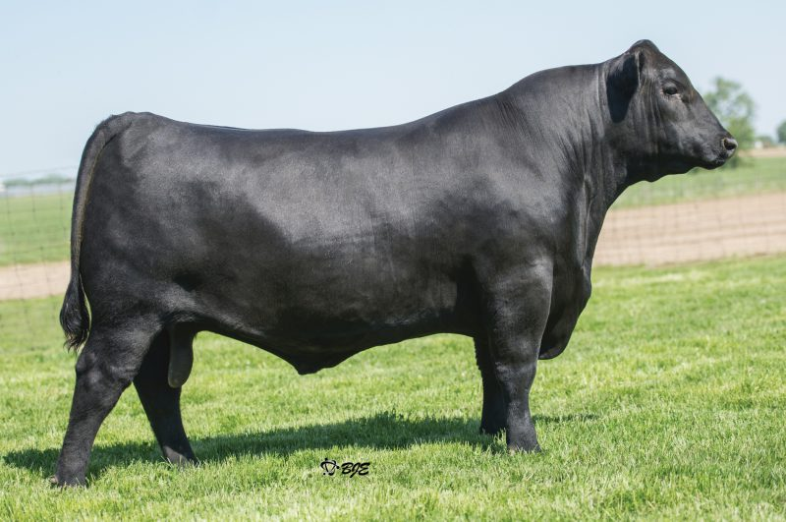
What breed?
1
Angus
Charolais
Gelbvieh
Hereford
A
B
C
D

Slide 3
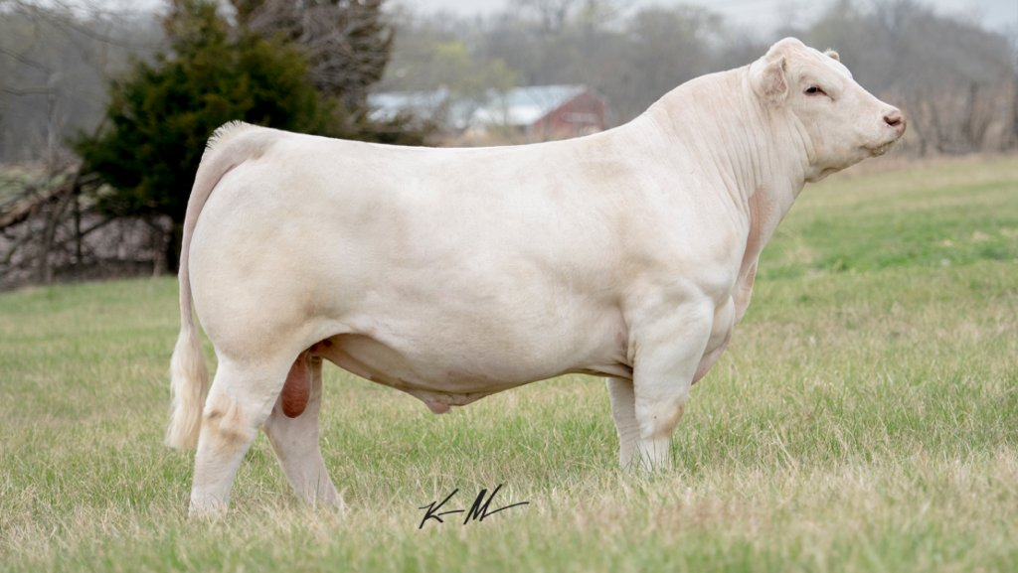
What breed?
2
A
Angus
Charolais
Simmental
Red Poll
B
C
D

Slide 4
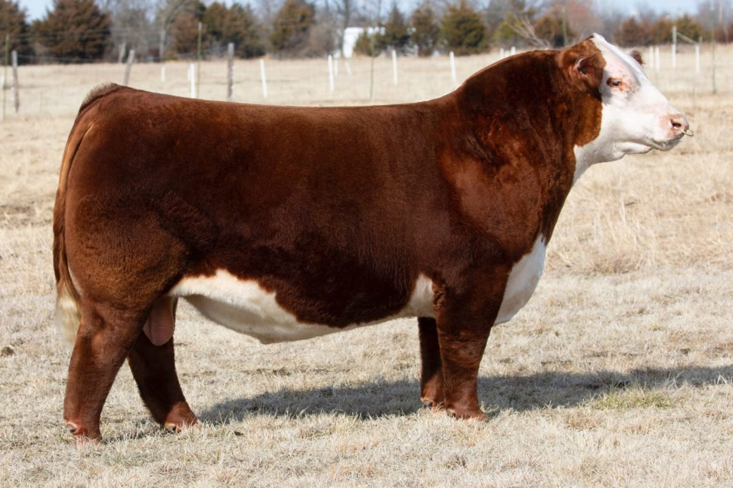
What breed?
3
Polled Hereford
Lim-Flex
Gelbvieh
Chiford
A
B
C
D

Slide 5
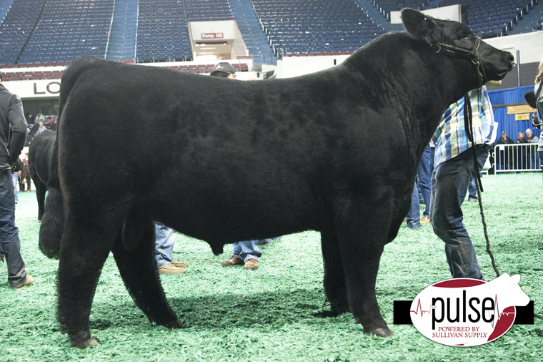
What breed?
4
A
Brangus
Chianina
Red Angus
Belted Galloway
B
C
D

Slide 6
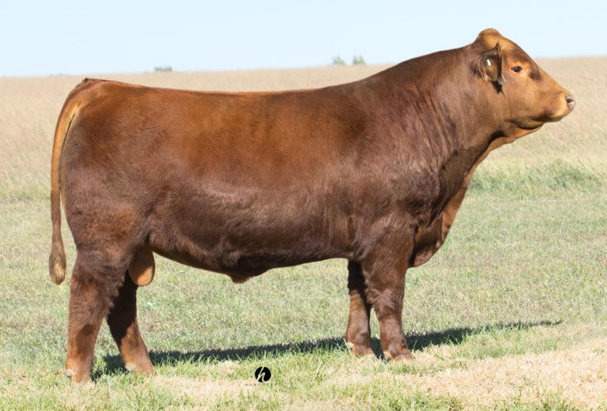
What breed?
5
A
Red Poll
Simmental
Brahman
Shorthorn
B
C
D

Slide 7
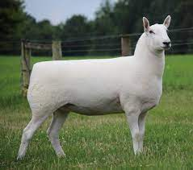
6
What Breed?
A
Tunis
B
Cheviot
C
Columbia
D
Southdown

Slide 8
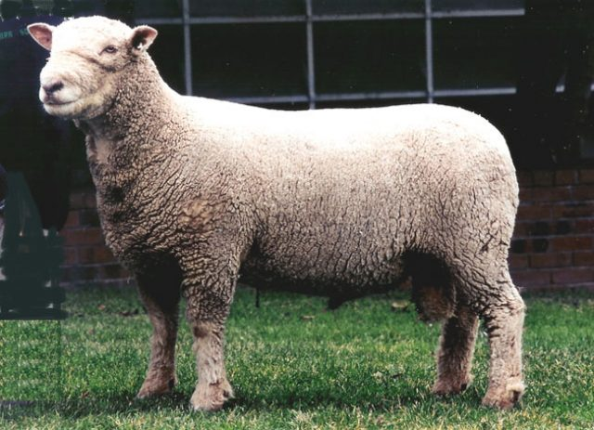
What breed?
7
Dorset
Southdown
Dorper
Montadale
A
B
C
D

Slide 9
What breed?
8
Dorper
Cotswold
Oxford
Hampshire
A
B
C
D

Slide 10
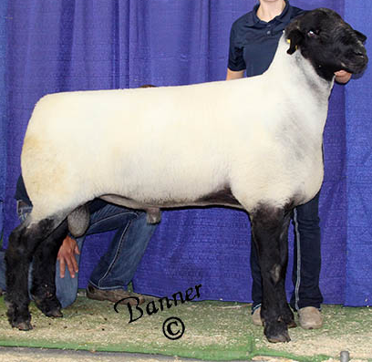
What Breed?
9
A
Oxford
Southdown
Romney
Suffolk
B
C
D

Slide 11
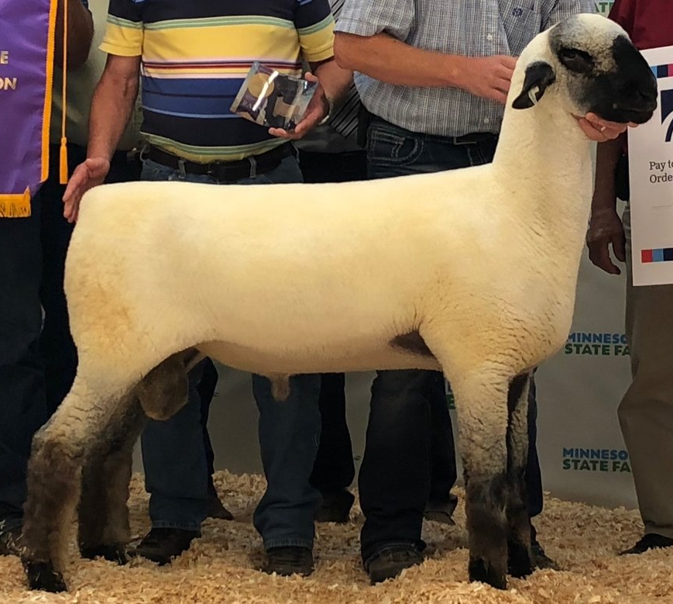
What breed?
10
Shropshire
Hampshire
Oxford
Columbia
A
B
C
D

Slide 12
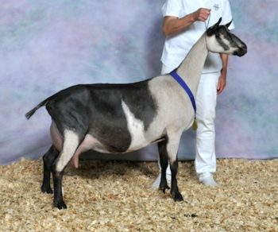
11
What breed?
A
Alpine
Toggenberg
Lamancha
Boer
B
C
D

Slide 13
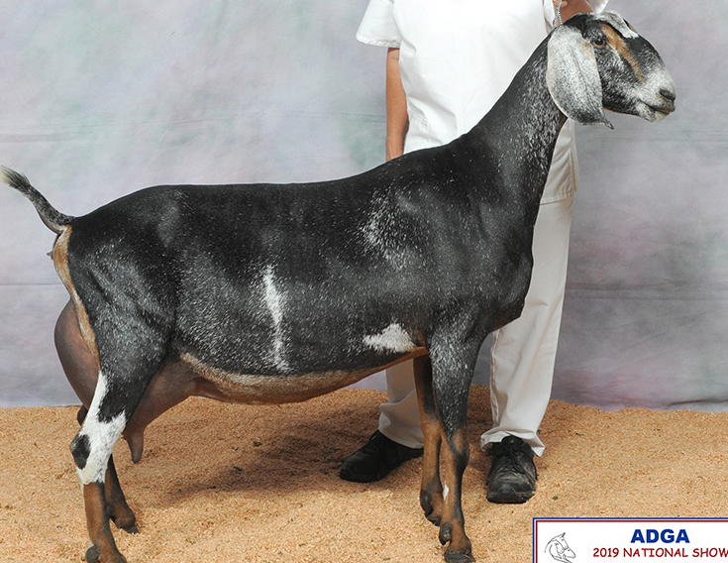
12
What breed?
A
Alpine
Toggenberg
Nubian
Tennessee Fainting
B
C
D

Slide 14
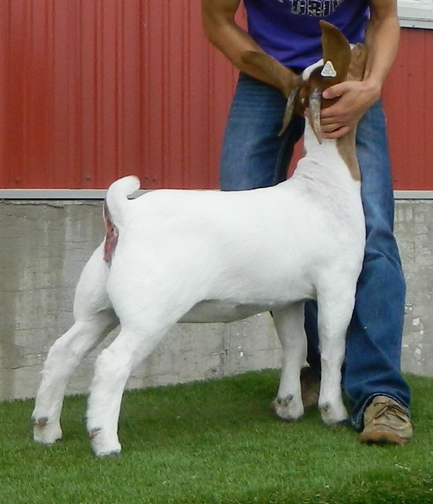
What Breed?
13
A. Boer
Kiko
Lamancha
Alpine
A
B
C
D

Slide 15
What Breed?
14
A
Alpine
Boer
Angora
Nubian
B
C
D

Slide 16
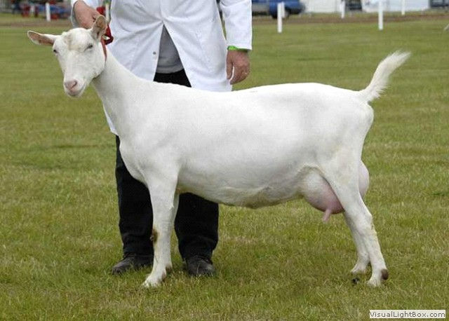
What Breed?
15
A
Lamancha
Boer
Sanaan
Pygmy
B
C
D

Slide 17
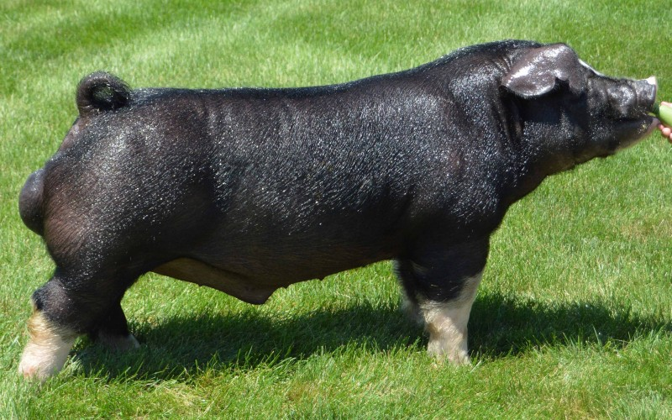
What Breed?
16
A. Berkshire
B. Poland China
C. Tamworth
Hereford
A
B
C
D

Slide 18
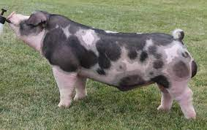
17
What Breed?
A
Spotted
Hereford
Tamworth
Hampshire
B
C
D

Slide 19
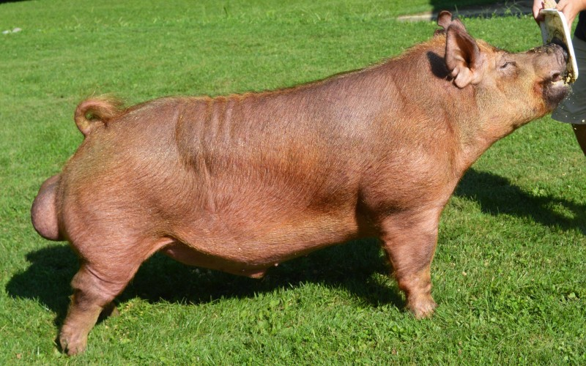
18
What Breed?
A
Hereford
Tamworth
Spotted
Yorkshire
B
C
D

Slide 20
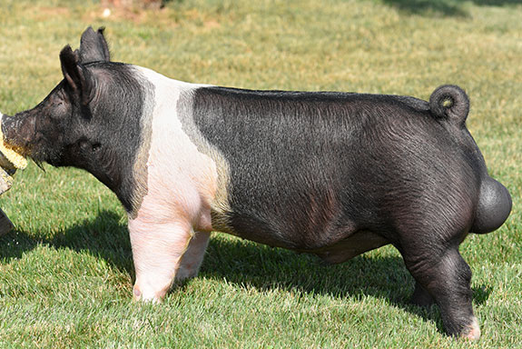
What Breed?
19
Chester
Poland China
Hampshire
Spotted
A
B
C
D

Slide 21
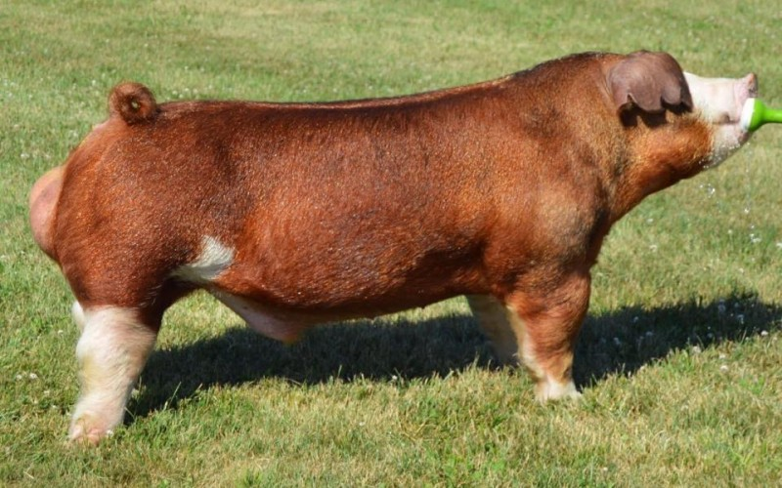
What Breed?
20
A
Hereford
Duroc
Red Wattle
Tamworth
B
C
D

Slide 22
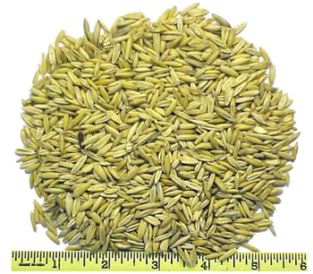
Name this Feed
21
Barley
Shelled Corn
Oats
Beet Pulp
A
B
C
D

Slide 23
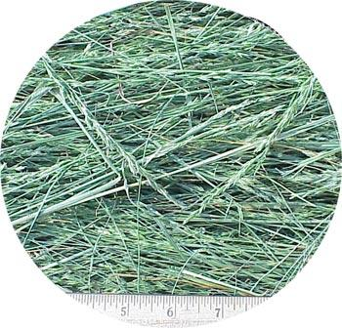
Name this Feed
22
Red Clover Hay
Timothy Hay
Orchard Grass Hay
Fescue Hay
A
B
C
D

Slide 24
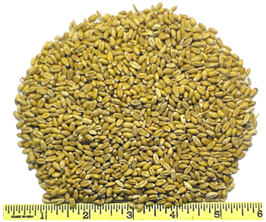
Name this Feed
23
Trace Mineral Salt
Soybeans
Corn
Wheat
A
B
C
D

Slide 25
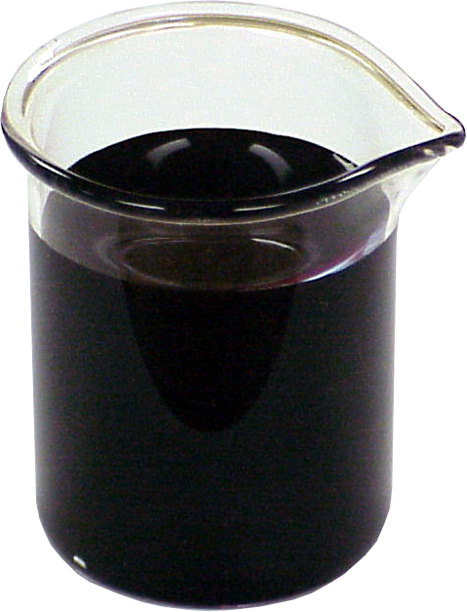
Name this Feed
24
A
Pepsi
Liquid Molasses
Motor Oil
Axel Grease
B
C
D

Slide 26
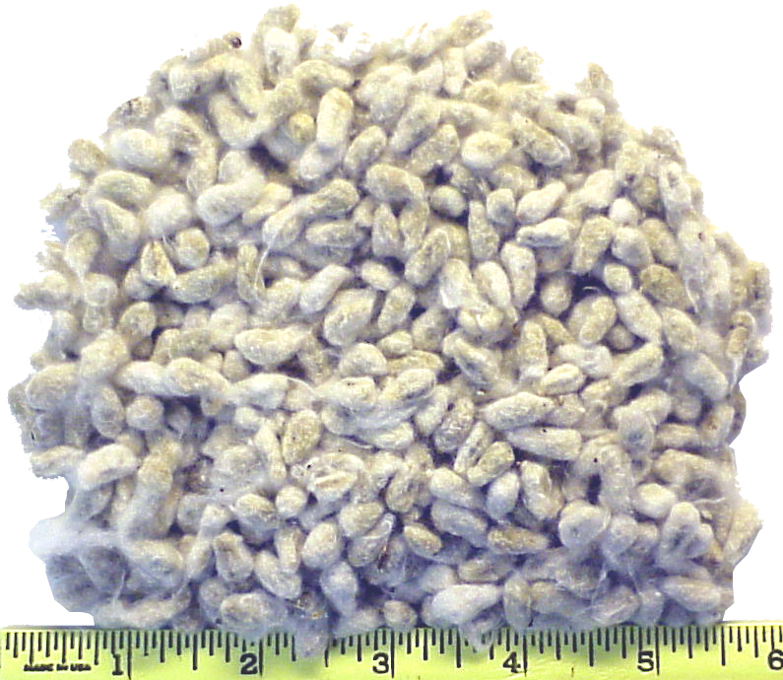
Name this Feed
25
Cottonseed Hulls
Cracked Corn
Steam rolled barley
Cereal
A
B
C
D

Slide 27
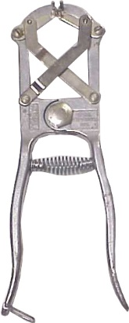
Name this Equipment
26
Pliers
Cutter
Pincher
Bander
A
B
C
D

Slide 28
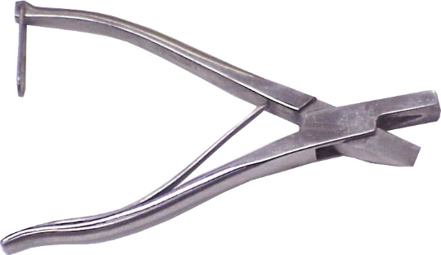
Name this Equipment
27
Wire Wrench
Ear Notcher
Hole Punch
Paper Cutter
A
B
C
D

Slide 29
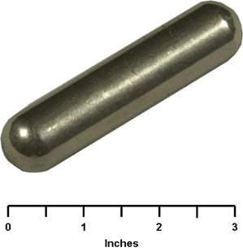
Name this Equipment
28
Water Heater
Bolus
Rumen Magnet
Horn trainer
A
B
C
D

Slide 30
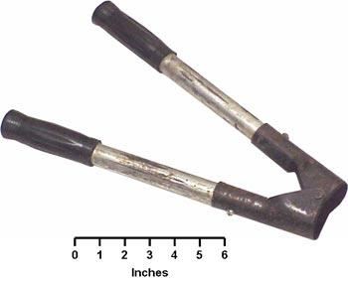
Name this Equipment
29
Barnes Dehorner
Clinch Cutter
Rasp
Tail Docker
A
B
C
D

Slide 31
Name this Equipment
30
A. Hammer
B. Fencing Pliers
C. Wire Wrench
D. Hoof Pick
A
B
C
D

Slide 32
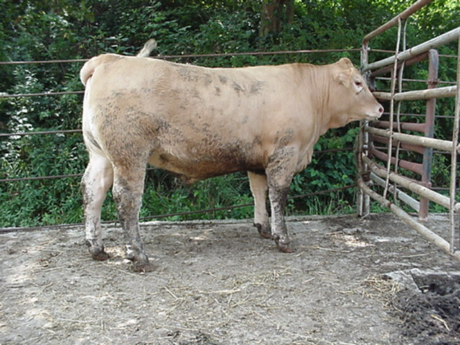
31
Name the body part
A
Crest
B
Muzzle
C
Head
D
Poll

Slide 33
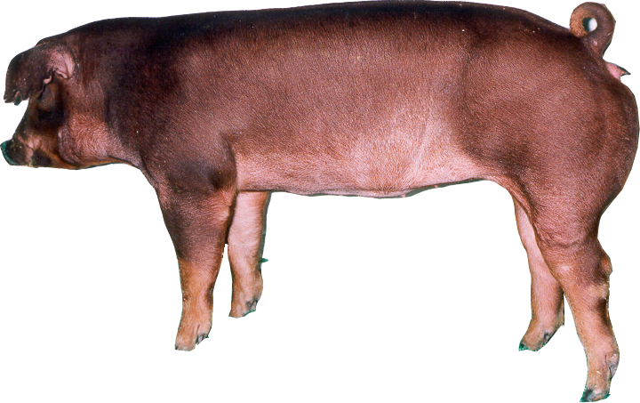
32
CUTS
A
Loin
B
Ham
C
Pigs feet
D
Ribs

Slide 34
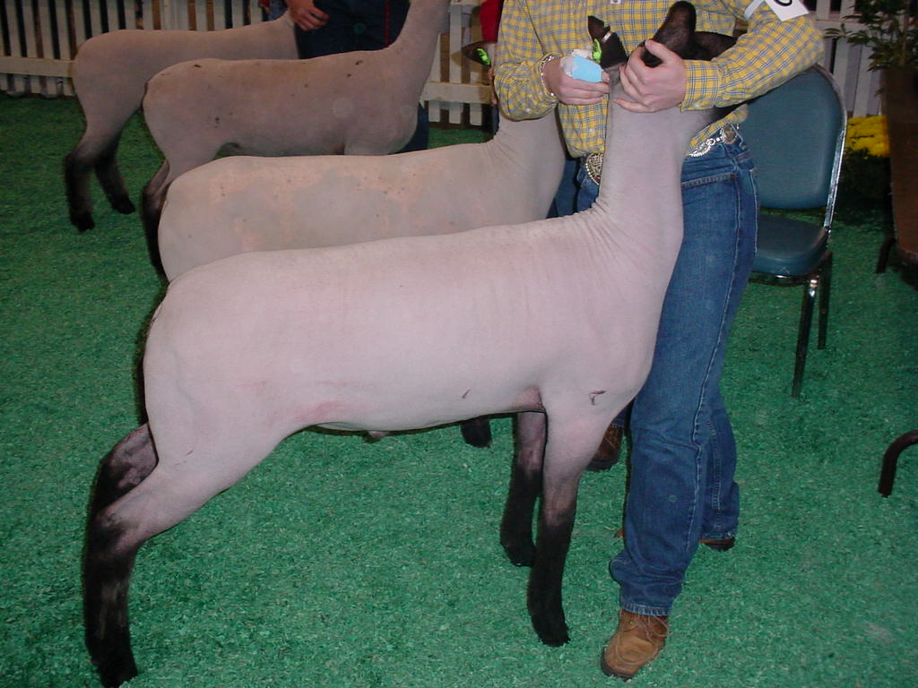
33
Loin of Lamb?
B
A
C
D

Slide 35
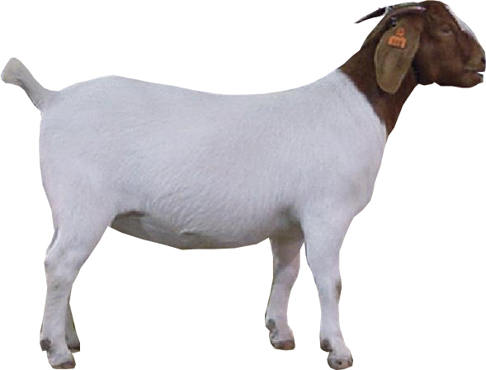
34
Name the body part
A. Hoof Hock Dewclaw D. Flank
A
B
C
D

Slide 36
35
B
A
C
D
E
Cuts
Flank?

Slide 37
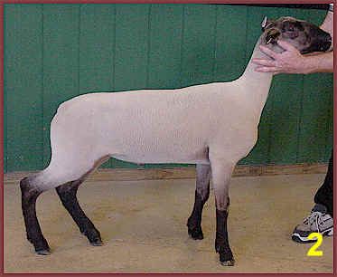
Which lamb is heavier structured?
36
A
B

Slide 38
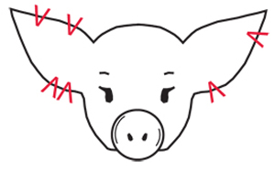
What is the litter number on this hog?
37
4
B. 36
C. 22
D. 38
A
B
C
D

Slide 39
Which of the following is not an energy feed?
38
A
Barley
Soybean Hulls
Steam flakes
Fish Meal
B
C
D

Slide 40
Which goat is the boldest in his rack?
39
A
B
C

Slide 41
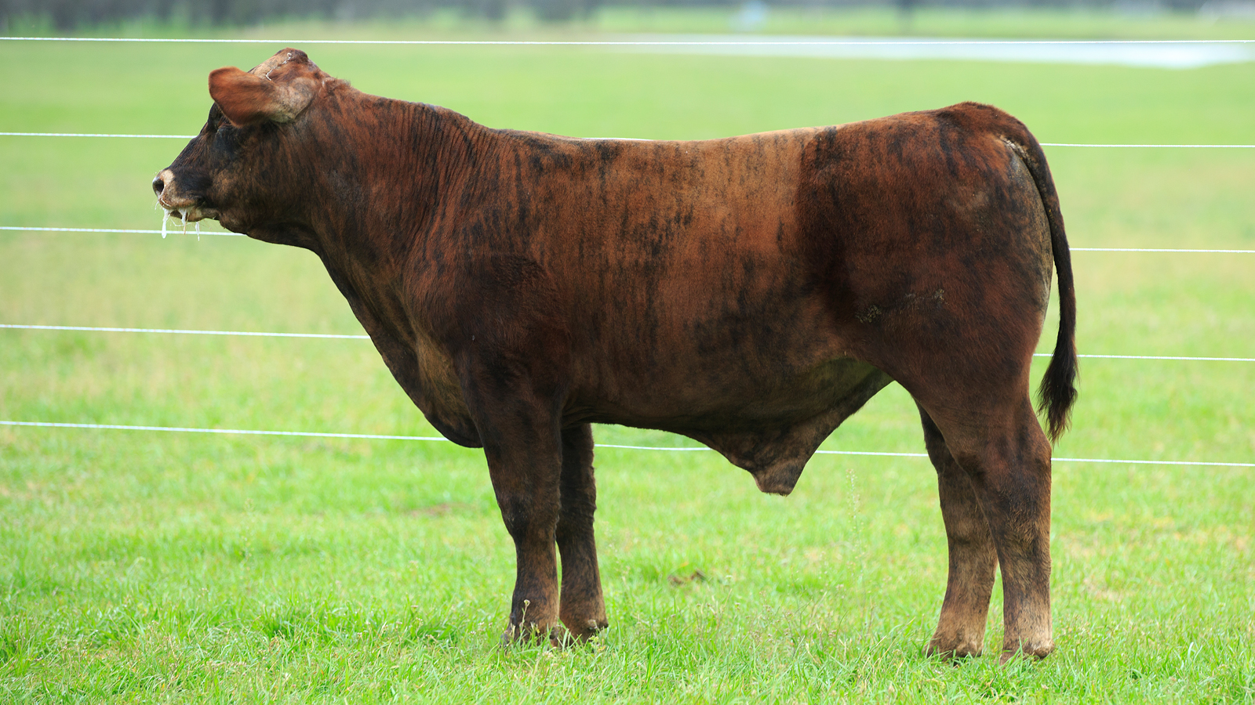
What would you call this steer?
40
A
Brown
Longhorn
Brindle
Roan
B
C
D

Slide 42
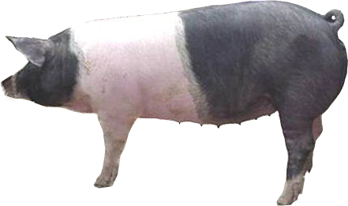
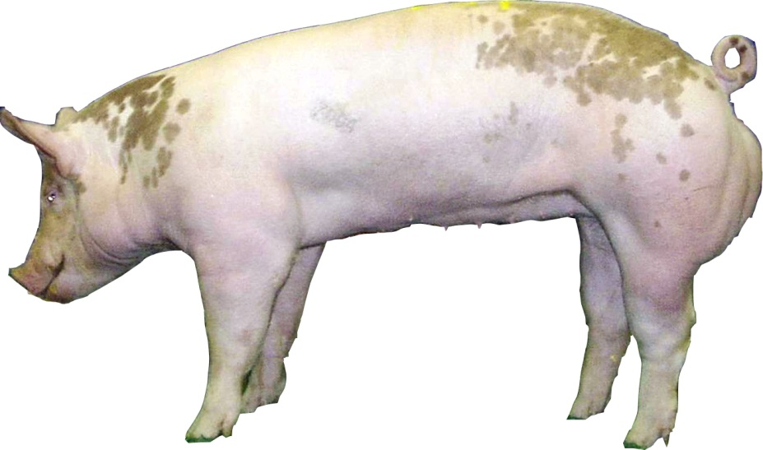
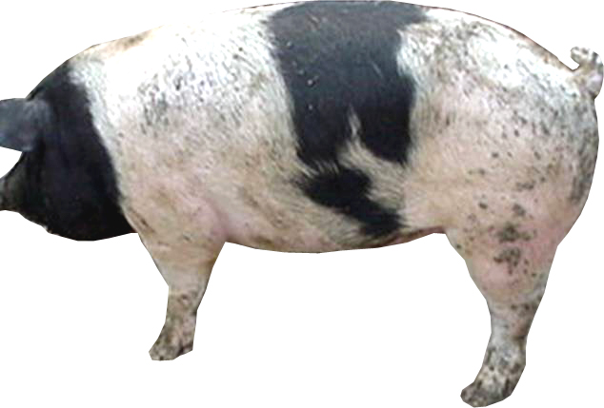
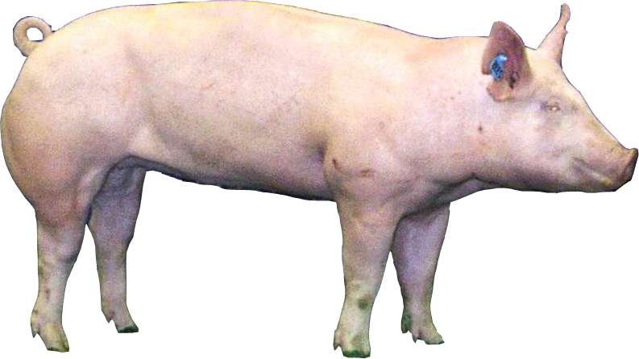
41
Which market hog is the fattest?
B
A
C
D

Slide 43
The term expressing the color change in freshly cut beef from dark purple to cherry red is which of the following?
42
A
Freshening
Bleeding
Reddening
Bloom
B
C
D

Slide 44
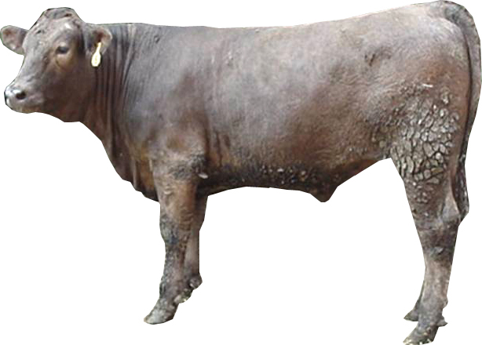
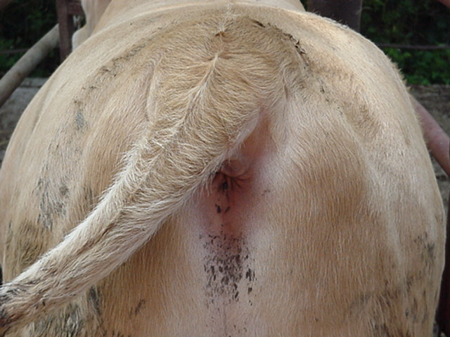
43
Which steer is fuller in his brisket and flank?
A
B

Slide 45
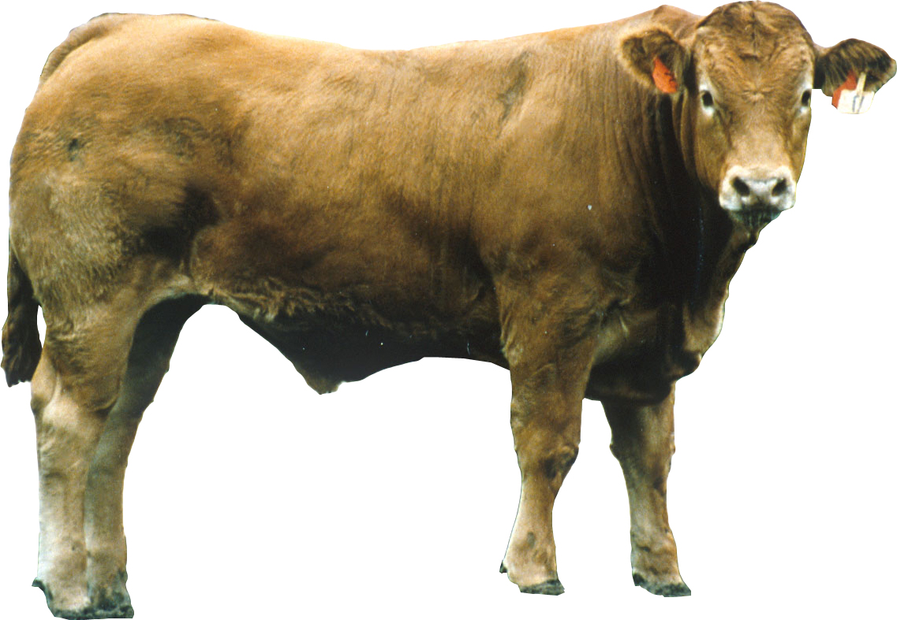
Which steer is the frailest structured and narrowest made?
44
A
B
C
D

Slide 46
What is wrong with this ewes rear structure?
45
A
Cow hocked
Bow legged
Wide based
All the above
B
C
D

Slide 47
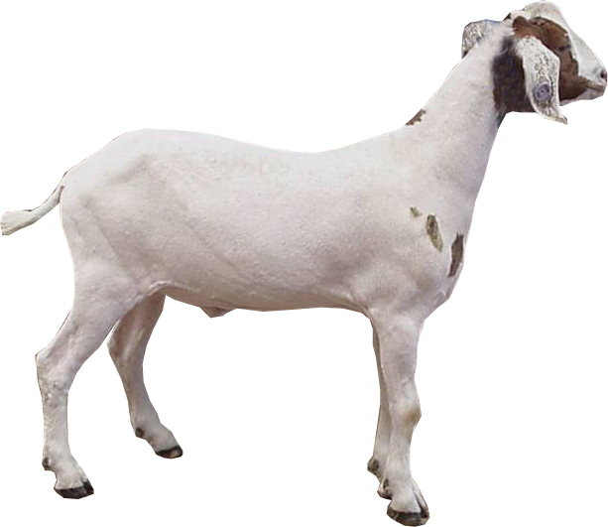
46
Which goat is the poorest structured?
A
B

Slide 48
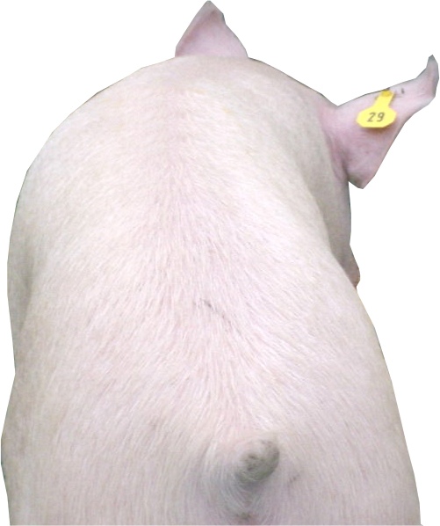
Which hog will have the largest loin eye area?
47
A
B
C

Slide 49
How can you tell how old sheep are without records?
48
A
Ask him his birthday
Length of hoof
Length of wool
Size of teeth
B
C
D

Slide 50
Polled cattle have ______.
49
A
Horns
No horns
A shallow body
Twins
B
C
D

Slide 51
50
A boar with one or both testicles retained within the body cavity is called a ___________?
Cryptorchid
Chomper
Unseen Boar
Boar Taint
A
B
C
D

